Slide 1
Exempt Organization Future Tax Leaders
International tax update
June 29, 2023

Slide 2
Disclaimer
The views expressed by the presenters are not necessarily those of Ernst & Young LLP or other members of the global EY organization.
These slides are for educational purposes only and are not intended to be relied upon as accounting, tax or other professional advice. Please refer to your advisors for specific advice.
EY refers to the global organization, and may refer to one or more, of the member firms of Ernst & Young Global Limited, each of which is a separate legal entity. Ernst & Young LLP is a client-serving member firm of Ernst & Young Global Limited operating in the US.
This presentation is © 2023 Ernst & Young LLP. All Rights Reserved. No part of this document may be reproduced, transmitted or otherwise distributed in any form or by any means, electronic or mechanical, including by photocopying, facsimile transmission, recording, rekeying, or using any information storage and retrieval system, without written permission from Ernst & Young LLP. Any reproduction, transmission or distribution of this form or any of the material herein is prohibited and is in violation of US and international law. Ernst & Young LLP expressly disclaims any liability in connection with use of this presentation or its contents by any third party.

Slide 3
Presenters
Jennifer Richter
Managing Director
Exempt Organization Tax Services
Ernst & Young LLP
Erin Wood
Senior Manager
Exempt Organization Tax Services
Ernst & Young LLP
Nimit Mehrotra
Senior Manager
Exempt Organization Tax Services
Ernst & Young LLP
David Taylor
Senior Manager
Information Reporting and Withholding
Ernst & Young LLP

Slide 4
Learning objectives
Recognize the updates to Forms 5471, 8858, 8990, 8991, 8992, and Schedules K-2 and K-3
Explain the Form 5471 filing requirements, categories of filers, and common pitfalls
Prepare for 2022 compliance
Discuss other current international tax topics
Analyze FATCA and CRS issues

Slide 5
Agenda
Overview of international form changes
Changes to Forms 5471 and 8865; Schedules K-2 and K-3; and Forms 8990, 8991 and 8992
Form 5471: filing requirements and categories of filers
Form 5471: common pitfalls
Getting ready for 2022 compliance
Other international tax topics
Foreign Account Tax Compliance Act (FATCA), Common Reporting Standard (CRS) and grants

Slide 6
Overview of international form changes

Slide 7
1
Let’s hear from you
Do you prepare your own international tax forms and computations?
Yes
No, third-party preparer
Co-source with outside provider
Use loan staff
Not applicable (EY organization, faculty, etc.)

Slide 8
Overview of international forms changes
Form type | Form status | Instruction status | Material new information
Form 5471 | Final as of 01/03/23 | Final as of 03/15/23 | Language updates to Sch. G questions regarding foreign derived intangible income (FDII) to align with final regulations, Line 14 table — Q18 clarified and new Q 22 added New line added to Sch. Q for “other” and new columns added for loss allocation; If Code “901j” is entered, report country code of sanctioned country “Category of Filers” section clarified and includes comprehensive summary for each category Schedule G-1 instructions require statement to be attached if Reg. Sec. 1.482-7(d)(3)(iii)(B) or Notice 2005-99 election made Changes to principal business and activity codes
Form 8858 | Final as of 09/30/21 | Final as of 09/30/21 | No changes to the form or instructions
Form 8865 | Final as of 11/09/22 | Final as of 02/6/23 | Language updates to Q12 regarding FDII to align with final regulations
Form 8865 Schedules K-2/K-3 | Final as of 11/14/22 | Final of 2/1/23 | Added “Reference ID” box on the top of every page Part III Section 4, Line 3 added “Contested Tax” checkbox Reporting guidance provided for passive foreign investment companies (PFICs) making a section 1296 election Exceptions to filing provided for Parts V, VI and VII for certain fact patterns
Form 1118 | Final as of 11/29/22 | Final as of 3/21/23 | Schedule A, Line 14 “Apportioned Share of Deductions” updated to reference revised Schedule H, Part II and III Schedule H, Part II — added stewardship deductions and other deductions allocated and apportioned based on assets Schedule H, Part III (New) — provides more detailed break down of “Other Deductions” Schedule L — New Part V for annual reporting for contested taxes
Form 1118 Schedule L | Final as of 11/30/22 | Final as of 01/03/23 | Instructions include minor language updates and guidance on how to attach a PDF to the tax return New columns added on Part III New Part V for annual reporting for contested taxes
Form 8990 | Final as of 1/24/23 | Final as of 1/25/23 | New Worksheet C to determine eligibility for safe-harbor election Instructions provide clarification regarding controlled foreign corporation (CFC) group election reporting
Form 8991 | Final as of 7/15/22 | Final as of 7/15/22 | No form change and minor instruction changes
Form 8992 | Final as of 12/14/22 | Final as of 1/3/23 | Schedules A and B require an Employer Identification Number (EIN) or reference IDs
Form 8993 | Final as of 12/23/21 | Final as of 1/18/22 | No changes to the form or instructions
Form 5472 | Final as of 12/14/22 | Final as of 1/20/23 | Language updates to Part VII question 41 regarding FDII to align with final regulations
Form 1120F | Final as of 1/20/23 | Final for Sch H, Sch P, Sch I and Sch M-3 1120-F | A corporate alternative minimum tax (CAMT) may apply to applicable corporations for tax years after 12/31/22 Principal business activity codes have been updated Forms 1042-S, 8805 or 8288-A must be attached to claim credits for withholding taxes Schedule H — If the foreign corporation receives a K-3, there are specific instructions for reporting expenses on Schedule H Schedule I — Updated to align with Reg. Section 1.882-5 Schedule P — List of Foreign Interests in Partnerships (Parts IV and V)

Slide 9
Form 5471 changes

Slide 10
Form 5471, updates to instructions
Clarification and organization of the category of filers
No technical changes to the categories but instructions now provide a comprehensive summary for each category and what exceptions apply specifically to each category of filer.
Organization of exceptions by category
“Exception From Filings” section renamed “Additional Filing Exceptions” and now includes only filing exceptions that apply to all categories (including added information with respect to multiple filers of the same information to Categories 4 and 5).
Added clarity around filing requirements, such as:
The definition of related constructive US shareholder; definition and foreign controlled Section 965 Specified Foreign Corporation (SFCs) for Category 1b and Category 1c purposes
Clarified 10% stock ownership requirements and clarified the definition of a US person for Category 3 filers
Added specific instructions for foreign sales corporation (FSCs)
Schedule G, Schedule J and Schedule P: confirms these schedules are not required for certain categories
Schedule G not needed for Categories 1b and 5b
Schedules J and P not needed for Categories 1b, 1c, 5b and 5c

Slide 11
Form 5471, Schedule G
Language updates regarding question 6, foreign-derived intangible income (FDII):
Question 6a was updated to clarify to report “transactions with the foreign corporation and the filer” instead of referring to transactions on Sch M.
Question 6b was updated to clarify “gross receipts derived from all sales of general property” instead of “gross income derived from sales, leases, exchanges, or other dispositions (but not licenses).“
Question 6c was updated to clarify “the amount of gross receipts derived from all sales of intangible property” instead of “gross income derived from a license of property.”
Question 6d was updated to clarify “the amount of gross receipts from all services … included in foreign-derived deduction eligible income (FDDEI)” instead of gross income.

Slide 12
Form 5471, Schedule G (cont.)
Schedule G, Line 14 table — Q18 clarified the exception of Subpart F due to meeting branch or sales rules.
Schedule G, Line 14 table — Q22 added to indicate if a distribution under S951(a)(2)(B) has been made, i.e., the reduction of Subpart F due to a distribution to a previous US Shareholder.

Slide 13
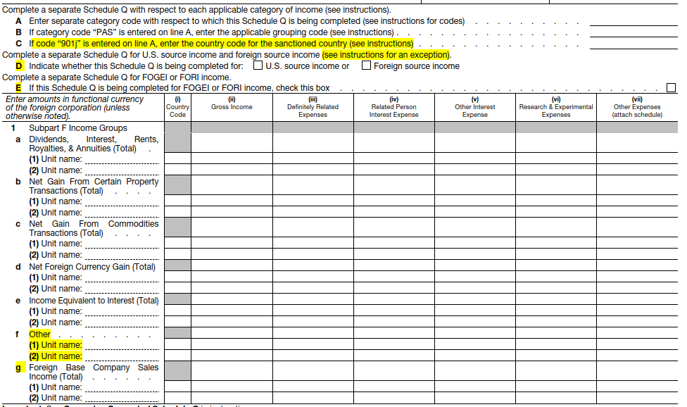
Form 5471, Schedule Q
New question C was added on the top of Page 1 for filers to complete country code for “901j” countries. See F1118 instructions for the list of countries. Boycott countries should be reported on row f, “Other.”
TY21 questions C and D on Page 1 are now questions D and E, respectively (due to the new question C added).
Added new row 1f “Other” with lines for 2 tested units on Page 1 and 3. “Catch All” for Sub F not captured elsewhere requiring a statement.
TY21 row 1f “Foreign Base Company Sales Income (Total)” was moved to row 1g (due to new row 1f added).

Slide 14
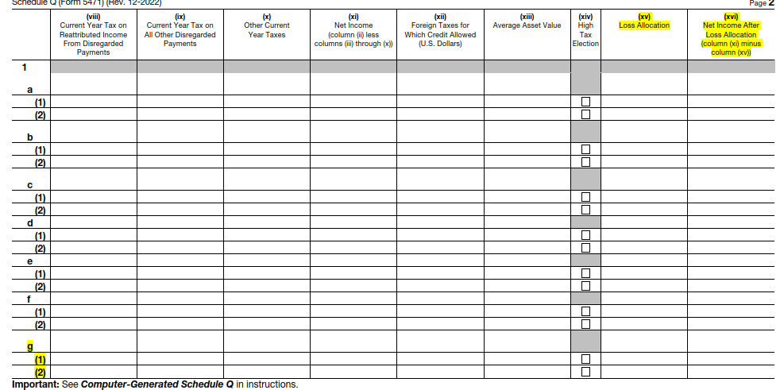
Form 5471, Schedule Q (cont.)
Two new columns added on pages 2 and 4 (replaced “Reserved” columns):
(xv) Loss Allocation
(xvi) Net Income After Loss Allocation
Instructions have not yet been released

Slide 15
Form 5471, other changes
Changes to principal business and activity codes.
Schedule G-1 instructions require statement to be attached if Reg. Section 1.482-7(d)(3)(iii)(B) or Notice 2005-99 election made:
Including the total amount of stock-based compensation taken into account as an intangible development cost (IDC) for the tax year pursuant to such election.
If a statement is attached, Line 6b should include the total amount of stock-based compensation taken into account as an IDC, including stock-based compensation to which an election has been made and any not subject to the election.
Schedule B — If a person is both a US shareholder and direct shareholder, that person’s information should be included in both Parts I and II.

Slide 16
2
Let’s hear from you
How many Forms 5471 will your organization file for the 2021 tax year?
1–5
6–10
More than 10
Unsure
N/A (EY employee)

Slide 17
Form 8865 changes

Slide 18
Form 8865 — instructions
New instruction for Item H14 question: “… the transfers between the partnership and its partners subject to the disclosure requirements of Regulations section 1.707-8, generally when:
Certain transfers to a partner are made within 2 years of a transfer of property by the partner to the partnership;
Certain debt is incurred by a partner within 2 years of the earlier of (a) a written agreement to transfer, or (b) a transfer of the property that secures the debt, if the debt is treated as a qualified liability; or
Transfers from a partnership to a partner occur which are the equivalent to those listed in (1) or (2) above.”
Updated: Principal Business Activity Code and List of Codes used for Schedule K-1 (8865)
Form language updates regarding FDII:
Page 1 question 12a was updated to clarify to report “transactions with the foreign partnership and the filer” instead of referring to transactions on Sch N.
Page 1 question 12b was updated to clarify “gross receipts derived from sales of all general property” instead of “gross income derived from sales, leases, exchanges or other dispositions (but not licenses).”
Page 1 question 12c was updated to clarify “gross receipts derived from all sales of intangible property” instead of “gross income derived from a license or property.”
Page 1 question 12d was updated to clarify “the amount of gross receipts from all services … included in FDDEI” instead of gross income.

Slide 19
Schedules K-2 and K-3

Slide 20
What we heard: Schedules K-2 and K-3 (2021 filing season)
Background to the 2021 K2 and K3 schedules includes:
Standardized format allows the IRS to perform data analytics
Direct IRS resources (select/not select returns)
Better understanding/transparency to partnership operations
Throughout the season, FAQs and clarifications were issued.
Penalty Notice 2021-39 provided relief during the transition period.
PDF attachments for Schedules K2 and K3 were allowed.

Slide 21
Schedules K-2 and K-3 (2022 filing season)
Notice 2021-39 relief will not be available for tax year (TY) 2022.
All the FAQs have been updated for the 2022 filing season.
Schedules K-2 and K-3 will have an e-file schema.
Updated instructions are in connection with updates to Forms 1116/1118.
Notes:
Lets mention that all forms are available in the resource Section of ON 24.

Slide 22
Schedules K-2 and K-3 changes from 2021 to 2022 forms
Schedules K-2 and K-3 Part | Description | Form changes from 2021 to 2022
8865 K-2 Header | General | Reference ID number has been added.
Part I | Partnership’s other current year international information | New part I, Box 12 to report additional 8865 information that may be needed for certain investors. On Sch K-2, Box 12 is reserved as it would not apply at the entity level. TY 2021 Box 12 (other international items) pushed to Box 13.
Part II | Foreign tax credit limitation (two sections) | No changes.
Part III | Other information for preparation of Forms 1116 or 1118 (five sections) | Section 4 has some new check boxes under Line 3 —foreign tax redeterminations for “Contested Tax.”
Part IV | Information on partners’ Section 250 deduction with respect to FDII (three sections) | No changes.
Notes:
Cathy lets talk about the updates to the instructions here: Box 1 we can toggle back and forth.
Slimmed down reporting
Table 1 in has been revised to require reporting of gains rather than both proceeds and basis.
Also, instead of reporting the date of sale of the property, if the gain is capital, the partnership will now report whether the gain is long-term or short- term.
Finally, the partnership may combine stock sales by country instead of listing each stock sale separately for that country.
Boxes 7, 8, 9
Instructions follow the changes made to TY 2021 instructions in the January 18th clarification, i.e., no need to attach Form 8621, 8858, or 5471 in most situations to each partner’s Sch K-3 unless such partner requires the information to prepare their own tax filings.
Box 9 — Removed reference to 8865. Exception is only for 8621. Still attach statement/footnote to say form attached to the return.
Box 12 and 13
The TY 2021 Box 12, Other International Items, has been moved to Box 13 for TY 2022. The new Box 12 is for “Form 8865 Information”
If the partnership transferred property to a foreign partnership that would subject one or more of its domestic partners to reporting (under 6038B and Regs. 1.6038B-2) but did not file Schedule O, Transfer of Property to a Foreign Partnership, containing all the information required, the partnership must provide necessary information for each partner to fulfill its reporting requirements.
Part II updates :
New country code XX
Instructions still highlight OC or Various should not be used
Like prior years, the IRS has provided instructions specifically excluding the use of the country code “OC” when providing the country breakout for sourcing separate categories of income, thus continuing to require a detailed breakout by country code.
For 2021, the instructions did not provide clear guidance on how to report country codes where the source of an item of gross income or gain (or a corresponding deduction) was determined by the partner.
Most partnerships reported such income under the country code “US” within Column (f) - Sourced by Partner The draft instructions added “XX” as a country code when the partnership cannot determine the country or US possession with respect to which the gross income and gross receipts are sourced because the source is determined by the partner.
The instructions seem to indicate that XX should only be used in Column (f) - Sourced by Partner and not other columns (e.g., foreign - passive) when the partnership cannot determine the country.
Net STCG example
Collectibles (28%) Gain and Loss, Unrecaptured Sec 1250 Gain - Line 13, 14, 29
Still no requirement to tie back any line item to a line item or total as reported on Form 1065, Sch K.

Slide 23
Schedules K-2 and K-3 changes from 2021 to 2022 forms
Schedules K-2 and K-3 Part | Description | Form changes from 2021 to 2022
Part V | Distributions from foreign corporations to partnership | No changes.
Part VI | Information on partners’ Section 951(a)(1) and Section 951A inclusions | No changes.
Part VII | Information to complete Form 8621 (two sections) | No changes.
Part VIII | Partnership’s interest in foreign corporation income (Section 960) | New Line (f) for Other was added. This additional line shifted all lines down a line. Column (iii)-Partners’ share of Average Assets value turned into “Reserved.”
Part IX- (Part VIII on the 8865) | Partners’ information for base erosion and anti-abuse tax (Section 59A) (two sections) | No changes.

Slide 24
Schedules K-2 and K-3 changes from 2021 to 2022 forms
Schedules K-2 and K-3 Part | Description | Form changes from 2021 to 2022
Part X Not on 8865 | Foreign partners’ character and source of income and deductions (four sections) | No changes.
Part XI | Section 871(m) covered partnerships | No changes.
Part XII | Reserved | No changes.
Part XIII (form 1065 Schedule K-3 only) | Foreign partner’s distributive share of deemed sale items on transfer of partnership interest | No changes.

Slide 25
Form 8990 changes

Slide 26
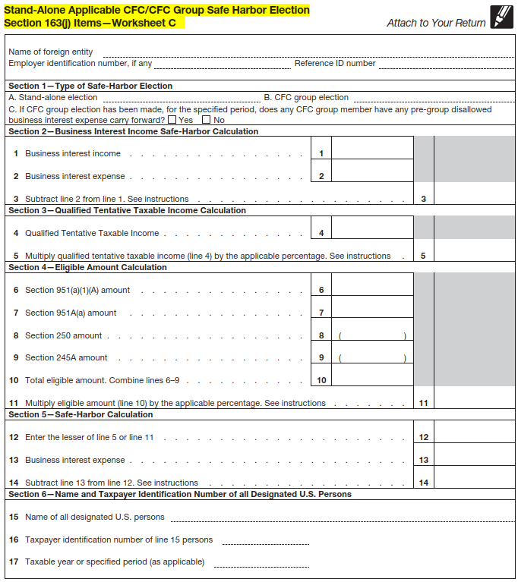
Form 8990 Limitation on Business Interest Expense Under Section 163(j)
New Worksheet C — Stand-Alone Applicable CFC/CFC Group Safe Harbor Election was added to instructions.
A spreadsheet is used to determine eligibility for the safe-harbor election under Reg. section 1.163(j)-7(h).
Complete the worksheet when a safe-harbor election is made and attach to your return.
If a safe-harbor election is made, Schedules A and B should not be completed.
If the safe-harbor election is met, see instructions for specific guidance on how to fill out the remaining Form 8990.

Slide 27
Form 8990 Limitation on Business Interest Expense Under Section 163(j) (cont.)
New questions B-D on Page 1
Part I, Section II, question 6, updated header to now say “Tentative Taxable Income“

Slide 28
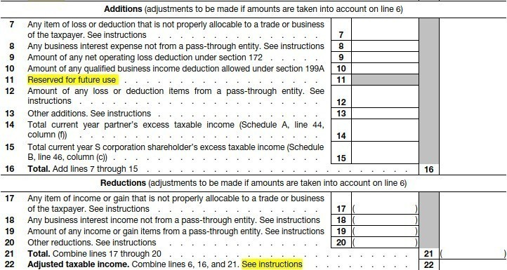
Form 8990 Limitation on Business Interest Expense Under Section 163(j) (cont.)
Part I, Section II, question 11, now “Reserved for future use“
Previously, this line was used for adding back deductions related to depreciation, amortization and depletion, which is no longer allowed.
Part I, Section II, question 22, added “See instructions”
If Line 22 is zero or less, enter zero; however, if a CFC group member has a negative amount of adjusted taxable income, the CFC group member should report the negative amount on Line 22.

Slide 29
Form 8990 Limitation on Business Interest Expense Under section 163(j) (cont.)
Schedule A — Summary of Partner’s Section 163(j) Excess Items — Columns (c) and (d) added “see instructions“
Line 43, column (c),
Instructions take out language from prior year instructions that addressed that the first tax year beginning in 2020 column (d) may not equal column (i) of the 2019 Form 8990, since this is no longer applicable.
Reduce the current year excess business interest expense by the amount of negative section 163(j) expense that relates to the current year excess business interest expense.
Line 43, column (d),
Instructions take out language from prior year instructions that addressed the first tax year beginning in 2020, since this is no longer applicable.
Prior year carryforward from Form 8990, Line 43 column (i), should be used for Form 8990, Line 43, column (i). Prior year carryover should be increased by the amount of negative section 163(j) expense that is no longer suspended or reduce the prior year excess business interest expense by the amount of negative section 163(j) expense that relates to the prior year excess business interest expense.
Statements must be attached for Line 43 columns (c) and (d) identifying the partnership name and amount of negative 163(j) expense and/or a description of the adjustments and the amounts.

Slide 30
Form 8991 changes

Slide 31
Form 8991 Tax on Base Erosion Payments of Taxpayers With Substantial Gross Receipts
Changes to form: none
Minor update issued on 7/31/22 to instructions for Schedule A, Line 9b (Qualified derivative payments excepted by Regs. Section 1.59A-6(b))
Updated reference from Notice 2021-36 in TY21 to Notice 2022-30 in TY22, which defers applicability of certain provisions of the regulations for reporting qualified derivative payments (QDP).
Extended the transition period until January 1, 2025.

Slide 32
Form 8991 Tax on Base Erosion Payments of Taxpayers With Substantial Gross Receipts (cont.)
Minor update issued on 2/3/23 to instructions.
Schedule C, Part II, Applicable Section 38 Credits, Line 10 — investment credit but only to extent of energy credit property under Section 48:
Line 10 states to enter only the total amount of investment credit allocable to the Section 48 energy credit shown on Line 4a, “Investment (Form 3468, Part III)” of all Parts III, Form 3800, with boxes A, B, C or D checked.
Since the 2022 revisions of Form 3468 made several changes to the lettered lines that constitute Line 12 (Energy credit) of Form 3468, the letter line references in the instructions for Sch C, Part II, Line 10 needed to be revised.
The Inflation Reduction Act of 2022 (IRA 2022) added several new or enhanced energy investment credits effective for periods after 2022. Fiscal year filers may be eligible to claim these credits for periods in 2023.

Slide 33
Form 8992 changes

Slide 34
Form 8992 US Shareholder Calculation of Global Intangible Low-Taxed Income (GILTI)
Minor change to Form 8992, Page 1, Part II, Line 5 (GILTI):
Updated to say “If zero or less, enter -0-” to align with the specific form instructions and make the form more intuitive.
No other technical and/or content changes from TY21.
Schedule A and B instructions clarify that “FOREIGNUS” and “APPLIED FOR” no longer valid options when completing the EIN/Reference ID column
If using reference ID, it must align with Form 5471.
Minor update in instructions on where corporate shareholders and individual shareholders are to report on the Form 1120 Sch C and Form 1040, respectively:
In the TY21 instructions, there were specific form line references provided. Whereas in TY22 it states to use the “appropriate lines.”

Slide 35
Form 5471: filing requirements and categories of filers

Slide 36
Form 5471 filing requirements
Section 6038 requires activities of a CFC to be reported on Form 5471.
Section 6046 requires that all information about acquisitions, dispositions or reorganizations of 10% or more of a foreign corporation be reported on Schedule O of Form 5471.
PDF of form: https://www.irs.gov/pub/irs-pdf/f5471.pdf
Form instructions: https://www.irs.gov/pub/irs-pdf/i5471.pdf
Categories 1a–5c:
New as of the 2020 revision
Form 5471 must be filed according to applicable categories.
Preparers should refer to the table in the instructions to verify filing requirements.

Slide 37
Form 5471 categories of filers
Category 1
A US person* who owns 10% or more of the combined voting power or value of all shares of classes of stock of a specified foreign corporation (SFC).
There are three types of Category 1 filers: Category 1a, 1b and 1c.
Category 2
A US citizen or resident who is an officer or director of a foreign corporation in which a US person* has acquired 10% of the vote or value of the foreign corporation or an additional 10% of the vote or value of the foreign corporation.
*Note: The definition of a US person changes depending on the category.

Slide 38
Form 5471 categories of filers (cont.) Note related to Category 1 filers
A US shareholder who is a Category 1 filer must continue to file all information required of a Category 1 filer as long as:
The Section 965 SFC (or foreign-controlled Section 965 SFC) has accumulated earnings and profits (E&P) related to Section 965 that are reportable on Schedule J (Form 5471).
Or
The Category 1 filer has previously taxed E&P related to Section 965 that is reportable on Schedule P (Form 5471).

Slide 39
Form 5471 categories of filers (cont.)
Category 3
A US person* who acquires stock in a foreign corporation that, when added to stock owned on the date of acquisition, equals 10% or more of the vote or value of the foreign corporation.
A US person* who acquires stock that, without regard to stock already owned on the date of acquisition, equals 10% or more of the vote or value of the foreign corporation.
A person who is treated as a US shareholder under Section 953(c) with respect to the foreign corporation.
A person who becomes a US person* while meeting the 10% stock ownership requirement with respect to the foreign corporation.
Or
A US person* who disposes of sufficient stock in the foreign corporation to reduce his or her interest to less than 10% of the vote or value of the foreign corporation.
*Note: The definition of a US person changes depending on the category.

Slide 40
Form 5471 categories of filers (cont.)
Category 4
A US person* who had control of a foreign corporation during the annual accounting period of the foreign corporation.
Control: owning stock possessing more than 50% of the combined voting power of all classes of stock of the foreign corporation or more than 50% of the total value of shares of all classes of stock of the foreign corporation
Category 5
A US person* who owns stock in a foreign corporation that is a CFC at any time during the tax year of the foreign corporation and who owned the stock on the last day in that year on which it was a CFC.
There are three types of Category 5 filers: Category 5a, 5b and 5c.
*Note: The definition of a US person changes depending on the category.

Slide 41
Form 5471: Certain Category 1 and 5 filers
The 2020 revision to Form 5471 included four new categories of filers:
Unrelated Section 958(a) US shareholder (Categories 1b and 5b)
Related constructive US shareholder (Categories 1c and 5c)
The new filing types provide relief for Category 1 and 5 filers who meet certain criteria (see Revenue Procedure 2019-40).
To be considered a certain Category 1 or 5 filer, the CFC or SFC must be considered a “foreign-controlled corporation.”
Foreign-controlled corporation:
For purposes of Category 1 and Category 5, a foreign-controlled corporation is a foreign corporation that is a CFC or an SFC that would not be a CFC or SFC if the determination were made without applying subparagraphs (A), (B) and (C) of Section 318(a)(3) so as to consider a US person as owning stock that is owned by a foreign person.

Slide 42
Form 5471: Certain Category 1 and 5 filers (cont.)
Unrelated Section 958(a) US shareholder:
For purposes of Category 1 and Category 5, an unrelated Section 958(a) US shareholder is a US shareholder with respect to a foreign-controlled corporation who:
Owns, within the meaning of Section 958(a), stock of a foreign-controlled corporation
Is not related (using principles of Section 954(d)(3)) to the foreign-controlled corporation
Related constructive US shareholder:
For purposes of Category 1 and Category 5, a related constructive US shareholder is a US shareholder with respect to a foreign-controlled corporation who:
Does not own, within the meaning of Section 958(a), stock of the foreign-controlled corporation
Is related (using principles of Section 954(d)(3)) to the foreign-controlled corporation

Slide 43
Form 5471 filing requirements

Slide 44
3
Let’s hear from you
Which foreign form will be the most challenging to complete this year?
Form 5471
Form 8865
Form 8858
Form 8991
Other

Slide 45
Form 5471: common pitfalls

Slide 46
Penalties for failure to file Form 5471 under Section 6038*
Potential loss of a portion of the foreign taxes available for credit under sections 901, 902 and 960.
A $10,000 penalty for each period for each foreign corporation (for tax periods after August 6, 1997)
An additional $10,000 fine if the form is not filed within 90 days of notice by the IRS and a $10,000 fine for each 30 days thereafter, for a maximum of $50,000 for each failure (for tax periods after August 6, 1997).
Criminal penalties that may apply for failure to file or for filing false or fraudulent information.
*Farhy v. Commissioner of Internal Revenue recently called into question the IRS’s ability to assess these penalties.

Slide 47
Things to watch for
As the first investor in a foreign corporation or partnership, high ownership percentages may trigger a filing.
If other investors divest of their ownership, your ownership could rise above 10% or change by 10%.
As additional investors are added, your ownership could fall below 10% or change by 10%.
If you invest in a foreign partnership that then invests in foreign corporations, you could be required to file Form 5471 and/or Form 926.
If you invest in “master-feeder” structures, there could be Form 5471 or 8865 filing requirements you aren’t aware of.

Slide 48
Example: indirect filing requirements
Facts:
US partner owns 55% of foreign partnership.
Foreign partnership owns 50% of foreign corporation at the end of the year.
Foreign partnership contributed $300,000 to foreign corporation during the tax year. Before the contribution, foreign partnership owned 30% of foreign corporation.
Foreign corporation is a CFC.
Filing requirements:
US partner will have a Category 1, Form 8865 filing requirement for its ownership in foreign partnership.
US partner will have a Category 3 and 5a, Form 5471 filing requirement for foreign corporation.
US partner will have a Form 926 filing requirement for the contribution made by foreign partnership to foreign corporation.
US partner
55%
Foreign
partnership
50%
Foreign corporation
Exempt Organization Future Tax Leaders | International tax update

Slide 49
Example: master-feeder structure
Facts:
Foreign feeder is treated as a corporation for US tax purposes.
Foreign master is treated as a partnership for US tax purposes.
US shareholder owns 55% of foreign feeder.
Foreign feeder owns 20% of foreign master.
Foreign master is a CFP.
There are no Form 8865, Category 1 filers for foreign master.
Filing requirements:
US shareholder will have a Category 4 and 5a, Form 5471 filing requirement for its ownership in foreign feeder.
US shareholder will have a Category 2, Form 8865 filing requirement for its indirect ownership in foreign master.
US shareholder
55%
Foreign feeder
20%
Foreign
master

Slide 50
4
Let’s hear from you
Is your organization invested in any master-feeder or other complex foreign structures?
Yes
No
Unsure
N/A (EY employee)

Slide 51
Getting ready for 2022 compliance

Slide 52
Getting ready for 2022 compliance
Understand filing requirements of all entities (e.g., category of filers).
Review and inventory all required data to determine any gaps.
Gather new data required early in the process.
Determine automation areas in compliance process.
Assess what your compliance software will and will not do and where you need to bridge the gap.
Set up milestones with review protocol (e.g., E&P, tested income) as opposed to review as a part of final form review.
Evaluate and streamline review process.

Slide 53
Other international tax topics

Slide 54
Considerations with international tax
New considerations with international tax
VAT/GST reporting
Other indirect taxes (e.g., India Equalization Levy)
Enforcement actions
Pillar Two/OECD initiatives
Expansion of remote working workforce
What’s not new but still bears careful consideration
Permanent establishment (PE) created by physical presence

Slide 55
What’s changing and why
Value-added tax (VAT) or goods and services tax (GST)
Recently introduced, or reporting definitions clarified to include e-commerce
Other types of indirect taxes introduced
India Equalization Levy
Enforcement is changing!
India and Singapore examples of countries proactively sending notices
Authorities may utilize sources not previously used:
Internet searches for online programs by foreign entities
Payment activity through government-controlled banks

Slide 56
PE and OECD Pillar Two
PE is a form of nexus and indicates a fixed place of business through which the foreign enterprise carries on its business.
PE types most relevant to exempt organizations: fixed place of business, service, agency
Once a PE is created, the US entity becomes subject to tax reporting in the foreign country and potential registration of its activities.
Many countries have taken stricter positions on PE in recent years due to the Organisation for Economic Co-operation and Development (OECD) initiatives.
Pillar Two is the most recent example of an OECD initiative which should be evaluated by your institution.

Slide 57
OECD Pillar Two — new global minimum tax
the Pillar
The OECD released model rules for new global minimum taxes under the initiative known as Pillar Two of the BEPS 2.0 project which provide a coordinated system interlocking rules designed to ensure that large multinational groups (global revenue of at least EUR750m) pay at least 15% corporate income tax in every jurisdiction in which they operate.
Policy objective
Political momentum
Model rules …
Ambitious timeline
Floor on international tax competition
End the “race to the bottom”
Key components agreed by 137 jurisdictions
Endorsed by the G20 finance ministers and leaders
… are a template for coordinated implementation of the global minimum tax by countries through their own domestic legislation
Global minimum tax rules enacted in 2023 and effective in 2024

Slide 58
Pillar Two — scope of GloBE
The Global Anti-Base Erosion Rules (GloBE) rules apply to constituent entities that are members of a multinational enterprise (MNE) group that has an annual revenue of EUR 750m or more, in the consolidated financial statements of an ultimate parent entity (UPE) in at least two of the four fiscal years immediately preceding the tested fiscal year.
MNE group means any group that includes at least one constituent entity or PE that is not located in the jurisdiction of the UPE.
Constituent entity is an entity that is included in a group and any PE of a main entity.
UPE is an entity that owns directly or indirectly a controlling interest (CI) in any other entity and is not owned with a CI directly or indirectly by another entity.

Slide 59
OECD Pillar Two — exclusions
Exclusions apply for: (not the full list)
Nonprofit organization
Pension fund
Governmental entity
Entities that are owned by one or more of the excluded entities also are excluded if specified ownership thresholds and activity conditions are satisfied.
Article 10.1.1 OECD GloBE model rules, i.e., suggested rules from the OECD which ultimately need to be enacted by each country
A nonprofit organization means an entity that meets all of the following criteria:
(a) It is established and operated in its jurisdiction of residence:
(i) Exclusively for religious, charitable, scientific, artistic, cultural, athletic, educational or other similar purposes Or
(ii) As a professional organization, business league, chamber of commerce, labor organization, agricultural or horticultural organization, civic league or an organization operated exclusively for the promotion of social welfare

Slide 60
OECD Pillar Two — exclusions (cont.)
(b) Substantially all of the income from the activities mentioned in paragraph (a) is exempt from income tax in its jurisdiction of residence.
(c) It has no shareholders or members who have a proprietary or beneficial interest in its income or assets.
(d) The income or assets of the entity may not be distributed to, or applied for the benefit of, a private person or non-charitable entity other than:
(i) Pursuant to the conduct of the entity’s charitable activities
(ii) As payment of reasonable compensation for services rendered or for the use of property or capital Or
(iii) As payment representing the fair market value of property which the entity has purchased
(e) Upon termination, liquidation or dissolution of the entity, all of its assets must be distributed or revert to a nonprofit organization or to the government (including any governmental entity) of the entity’s jurisdiction of residence or any political subdivision thereof; but does not include any entity carrying on a trade or business that is not directly related to the purposes for which it was established.

Slide 61
OECD Pillar Two — next steps
An institution should internally evaluate the model rules to determine if each of its foreign entities meet the “excluded entity” definition and document that position. Reach out to external experts, if needed.
Overall, filing requirements are unclear; although, if all entities are excluded, it could possibly result in no GloBE Information Return (GIR) filing (although this will need to be further evaluated when local countries issue further guidance).

Slide 62
Continued!
Evolving tax reporting that may impact online activities
(and other types of e-commerce)

Slide 63
Example of an evolving landscape: India
Similar to legislation enacted in the UK, Italy, France and certain other countries, India introduced a law to tax cross-border digital transactions.
The tax, known as an equalisation levy (EL), is payable at 2% of the consideration received and is effective from April 1, 2020.
In our experience, the EL will apply to most digital supplies, though specific characteristics of such programs would need to be evaluated.
Services provided to a person resident in India or a person using an IP address located in India is covered under the EL.
Good news? The threshold for applicability of the EL (based on gross receipts) is INR20m (approx. $270,000) during the Indian tax year (April 1 to March 31).
still adopt the Pillar

Slide 64
India also expands scope of ‘digital GST’ to non-automated services Applicable to online programs being offered by foreign institutions
What is the current law?
Foreign entities (e.g., US institutions) providing certain online services (i.e., Online Information Database Access and Retrieval (OIDAR) services), to Indian customers need to register and pay GST in India.
OIDAR is a service whose delivery is mediated by information technology, whereby its supply is essentially automated and involving minimal human intervention.
What is the proposed amendment?
The condition for OIDAR services to be “essentially automated and involving minimal human intervention” is removed.
As a result, any digital service, such as online or distance learning programs provided to an Indian customer (i.e., student) who is unregistered for GST would trigger GST registration and payment.
What is the impact to US entities?
The proposed amendments would expand the scope of GST to include all live educational or training programs, as well as sale of published educational content (e.g., sales by the university press or journals or telemedicine).
Note: There are no monetary thresholds for applicability of GST on OIDAR services.
There are also increased levels of scrutiny and enforcement actions by the local tax authorities.

Slide 65
Singapore expands scope of ‘digital services’ to ‘remote services’ Applicable to online programs being offered by foreign institutions
What was previous law?
GST was imposed on imported services by way of a reverse charge (RC) and an overseas vendor registration (OVR) effective from January 1, 2020; however, non-digital services (such as online programs and distant learning and telemedicine) were not subject to GST as long as there was sufficient human interaction.
What is the new law?
Effective January 1, 2023, a foreign institution which generates revenue from non-GST registered customers in Singapore exceeding S$100,000 (about US$74,000) would have a GST registration requirement in Singapore. The new GST rules apply to digital and non-digital services (i.e. remote services).)
What is the impact to US entities?
The proposed amendments would expand the scope of GST to include all live educational or training programs, as well as sale of published educational content (e.g., sales by the university press or journals or telemedicine).
There are also increased levels of scrutiny and enforcement actions by the local tax authorities.

Slide 66
What should institutions do today?
1
Monitor OECD developments and changing country laws.
2
Understand changes in countries that are relevant to your entity’s footprint.
3
Obtain information regarding applicable activities (e.g., online programs, telemedicine or journals).
4
Assess implications of potential new tax compliance obligations.
5
Communicate internally with departments.
6
Take steps to register and settle outstanding taxes and penalties (if necessary).

Slide 67
Remote workers
Considerations with employees working abroad

Slide 68
5
Let’s hear from you
Are remote worker issues relevant to your organization?
Yes
No
Unsure
N/A (EY employee)

Slide 69
The path to success: a roadmap for remote work outside the US
Develop process to identify and manage ongoing remote workers.
Identify your current
remote worker population.
Identify gaps between current reporting and locally required.
6
Develop remote worker policy.
5
3
1
4
2
Employment tax compliance
Complete a remote work risk assessment.
Employees working abroad for more than 90 or 183 days are likely to have individual income tax liability abroad.
Many countries hold the individual responsible for tax reporting if there is no PE by the employer.
Certain countries have withholding and remittance requirements even in the absence of PE .
Examples: Canada, France, Israel, Ireland (not an exhaustive list)
Understand remote work legal risks
(e.g., immigration and labor laws).
Exempt Organization Future Tax Leaders | International tax update

Slide 70
Additional considerations (not an exhaustive list)
Immigration requirements begin on day one (if not a citizen of the local country).
If an employee is expecting an “expat” arrangement to be made whole on taxes while still on US payroll, these can be very complicated and expensive arrangements.
Labor regulations and cultural expectations may be different from the US; the employee may require a locally compliant employment agreement.
Converting an employee to an independent contractor is not a recommended option.
Consider engaging a professional employment organization (PEO) even in the absence of a PE.

Slide 71
Foreign Account Tax Compliance Act (FATCA), Common Reporting Standard (CRS) and grants

Slide 72
FATCA and CRS overview
FATCA was enacted on March 18, 2010, as part of the Hiring Incentives to Restore Employment (HIRE) Act and is effective as of July 1, 2014.
FATCA impacts Foreign Financial Institutions (FFIs) and US Withholding Agents (USWAs).
Generally, FFIs include depository institutions, custodial institutions, investment entities, certain types of insurance companies that have cash value products or annuities.
CRS is an information model developed and approved by the OECD on July 15, 2014, for the automatic exchange of information (AEOI) to support international tax transparency. The standard is enacted via local legislation and Competent Authority Agreements (CAAs) signed between participating countries.
Approximately 100 countries participate in CRS globally.
The US is not a CRS participating jurisdiction.
Note: Banks can have investment funds as well.

Slide 73
FATCA and CRS IITC executive summary
FATCA and CRS have created complex and costly compliance burdens in addition to existing regimes. | Exempt organizations and institutional investors face challenges to achieve compliance.
Numerous jurisdiction-specific requirements continue to evolve and expand; current guidance is unclear. Compliance with these new laws requires an understanding of the new documentation, reporting and withholding requirements from the perspective of a payor and a payee. Endowments, pensions and tax excepts are investing around the globe, creating complications, specifically so as the US is not a participating CRS jurisdiction. | There could be a lack of awareness and understanding of requirements. Skill sets and systems are needed that have non-core capabilities (e.g., accounts payable, treasury, legal and investments all required to comply). Grants/scholarships/endowments made to non-US recipients are often complicated and factually driven — the regulations are not easy to navigate in this area, creating exposure. This is pressure to supply the Controlling Person’s personal information for exempt organizations and institutional investors.
Emerging global reporting requirements present a challenge for exempt organizations and institutional investors, both in an accounts payable sense, but also driven by the documentation required by your investment relationships.
The EY Information Reporting and Withholding team can help you.
Assist you in your information reporting and tax withholding responsibilities.
Minimize costs and intrusiveness of compliance while simultaneously reducing potential exposures for withholding taxes, interest and penalties.
Keep you informed of the latest developments.
Interpret the effects of new and existing rules and regulations on your organization.
Guide you in effectively implementing these rules and regulations throughout your organization.
Implement technological solutions that are cost-efficient, proven, sustainable and reliable.

Slide 74
FATCA vs. CRS — a comparison
 | US FATCA | CRS
Purpose | Identify/report certain US persons and US-owned foreign entities | Identify/report certain tax residents in CRS jurisdictions and entities controlled by tax residents
Due diligence | US and Non-IGA: W-8s/W-9s (and documentary evidence offshore) IGA: W-8s/W-9s and self-cert | Self-certification
Withholding | Traditional IRS penalties 30% withholding on US-source income (except generally no withholding by FFIs in Model 1 IGA jurisdictions) | No withholding
Reporting | Who reports? Financial Institutions Who is reported? US individuals, US entities and US owners of foreign entities | Who reports? Reporting Financial Institutions Who is reported? Individuals and entities resident in CRS jurisdictions and tax resident owners of entities resident in other jurisdictions
Responsible Officer (RO) certification | Model 1 IGA: N/A Model 2 IGA/PFFI: Yes | N/A
Noncompliance | 30% withholding on US-source income may be required for noncompliance (except in Model 1 IGA jurisdictions) | Penalties may be imposed under domestic law

Slide 75
Entities analysis of CRS — an overview
Entity
Financial Institution (FI)
Non-financial entity (NFE)
Reporting FI
Non-reporting FI
Active NFE
Passive NFE
Depository institution
Governmental entity
Income and asset test
NFEs that don’t qualify as active NFEs
Custodial institution
International organization
Publicly traded/affiliate
PMIE in non-participating jurisdiction
Investment entity
Central bank
Government and international organization
Specified insurance company
Certain retirement fund
Holding
Qualified credit card issuer
Start-up
Exempt collective investment vehicle
Entity in reorganization/bankruptcy
Trustee documented trust
Treasury
Low-risk FI
Not-profit entity

Slide 76
6
Let’s hear from you
Is the US a CRS participating jurisdiction?
Yes
No
Unsure

Slide 77
Scholarships and fellowship grants to non-degree candidates
If the non-resident alien (NRA) receiving the scholarship or fellowship grant is not a candidate for a degree and is present in the US under an F, J, M, or Q visa, the amount is subject to a 14% withholding rate on the total amount that is from US sources if the following requirements are met:
1
The grant must be for study, training or research in the US.
2
The grant must be made by:
A
A tax-exempt organization operated for charitable, religious, educational, etc., purposes
B
A foreign government
C
A federal, state, or local government agency
D
An international organization, or a binational or multinational educational or cultural organization created or continued by the Mutual Educational and Cultural Exchange Act of 1961 (known as the Fulbright-Hays Act)
If the grant does not meet both (1) and (2) above, the payment is subject to 30% withholding on the amount of the grant that is from US sources.

Slide 78
Targeted grants issued to NRAs
Targeted grants are payments made to achieve a specific objective, produce a report or similar project or improve or enhance literary, scientific, artistic, musical, teaching or other similar capacity, skill or talent of the grantee. They are generally not considered US-sourced and not subject to Form 1042-S reporting or withholding when paid to NRAs if certain requirements are met:
The payment must be made by a 501(c)(3), or federal/state government or instrumentality.
The payment must be made for activities conducted outside the US by a foreign person.
The payment cannot qualify as a scholarship and cannot be intended for the purpose of aiding the grantee to perform study, training or research, nor can it be more properly considered salary or other compensation for services.

Slide 79
EY | Building a better working world
EY exists to build a better working world, helping to create long-term value for clients, people and society and build trust in the capital markets.
Enabled by data and technology, diverse EY teams in over 150 countries provide trust through assurance and help clients grow, transform and operate.
Working across assurance, consulting, law, strategy, tax and transactions, EY teams ask better questions to find new answers for the complex issues facing our world today.
EY refers to the global organization, and may refer to one or more, of the member firms of Ernst & Young Global Limited, each of which is a separate legal entity. Ernst & Young Global Limited, a UK company limited by guarantee, does not provide services to clients. Information about how EY collects and uses personal data and a description of the rights individuals have under data protection legislation are available via ey.com/privacy. EY member firms do not practice law where prohibited by local laws. For more information about our organization, please visit ey.com.
© 2023 Ernst & Young LLP
All Rights Reserved.
US SCORE No. 20265-231US |2306-4264321
ED None
This material has been prepared for general informational purposes only and is not intended to be relied upon as accounting, tax or other professional advice. Please refer to your advisors for specific advice.
ey.com

